Slide 1



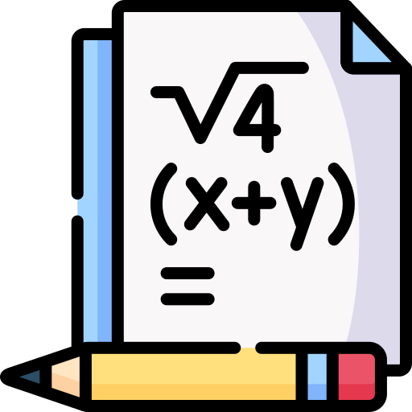
Assessing the Creativity of LLMs in Proposing Novel Solutions to Mathematical Problems
39-th AAAI
Conference on
Artificial
Intelligence
Speaker: Junyi Ye
Junyi Ye¹, Jingyi Gu¹, Xinyun Zhao¹, Wenpeng Yin², Guiling Wang¹
¹New Jersey Institute of Technology, ²The Pennsylvania State University
March 2, 2025

Slide 2

Motivation
Standard Definition of Creativity
AI advancements, especially in Large Language Models (LLMs), have improved complex problem-solving capabilities.
LLMs have excelled on challenging mathematical benchmarks like GSM8K, MATH and AIME.
🔹 Potential for creative problem-solving with LLMs remains underexplored.
Creativity = Novelty + Usefulness (Runco & Jaeger, 2012).
Usefulness = Correctness.
Novelty is harder to measure in mathematics.
Generated Solution
Explored
Under-explored
Correctness
Novelty
Notes:
AI has made significant strides, particularly in the development of LLMs capable of tackling complex problem-solving tasks.
Models like GPT-4 and Gemini have excelled on challenging mathematical benchmarks like GSM8K, MATH and AIME, highlighting the evolving role of LLMs from basic text generation to handling complex mathematical tasks.
However, the potential for creative problem-solving with LLMs remains underexplored.

Slide 3
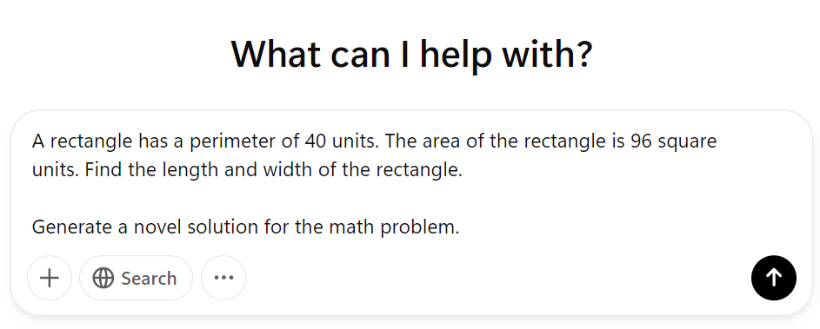
How to Generate A Novel Solution with LLM?
This does NOT work
Challenges:
Abstract Nature of "Novel".
Difficult to control the degree of “Novelty”.
Notes:
Abstract Nature of "Novel" Defining what constitutes novelty can be subjective and context-dependent.

Slide 4
How to Generate Novel Solutions with LLM?
Our approach: Generate new, correct solutions distinct from human-provided ones.
Novel Solution Generation:
🔹 Input: A math problem + k known solutions.
🔹 LLM generates a new solution.
Challenges:
Abstract Nature of "Novel".
Difficult to control the degree of “Novelty”.
Provide a clearer definition of novel = distinct.
k can be used to control the degree.
Much easier

Slide 5
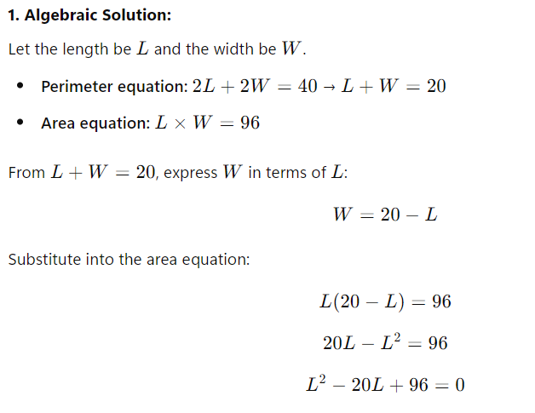
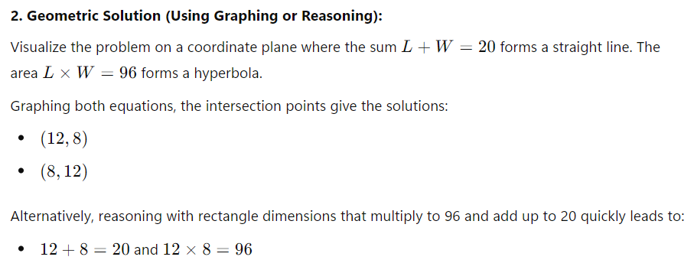
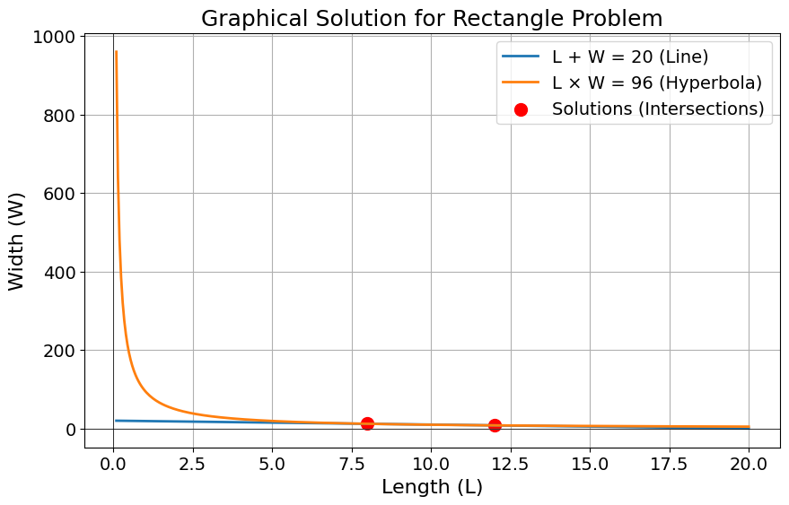
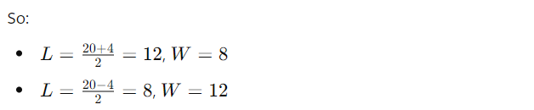
Approach 1 (Algebra)
Approach 2 (Geometry)

Slide 6
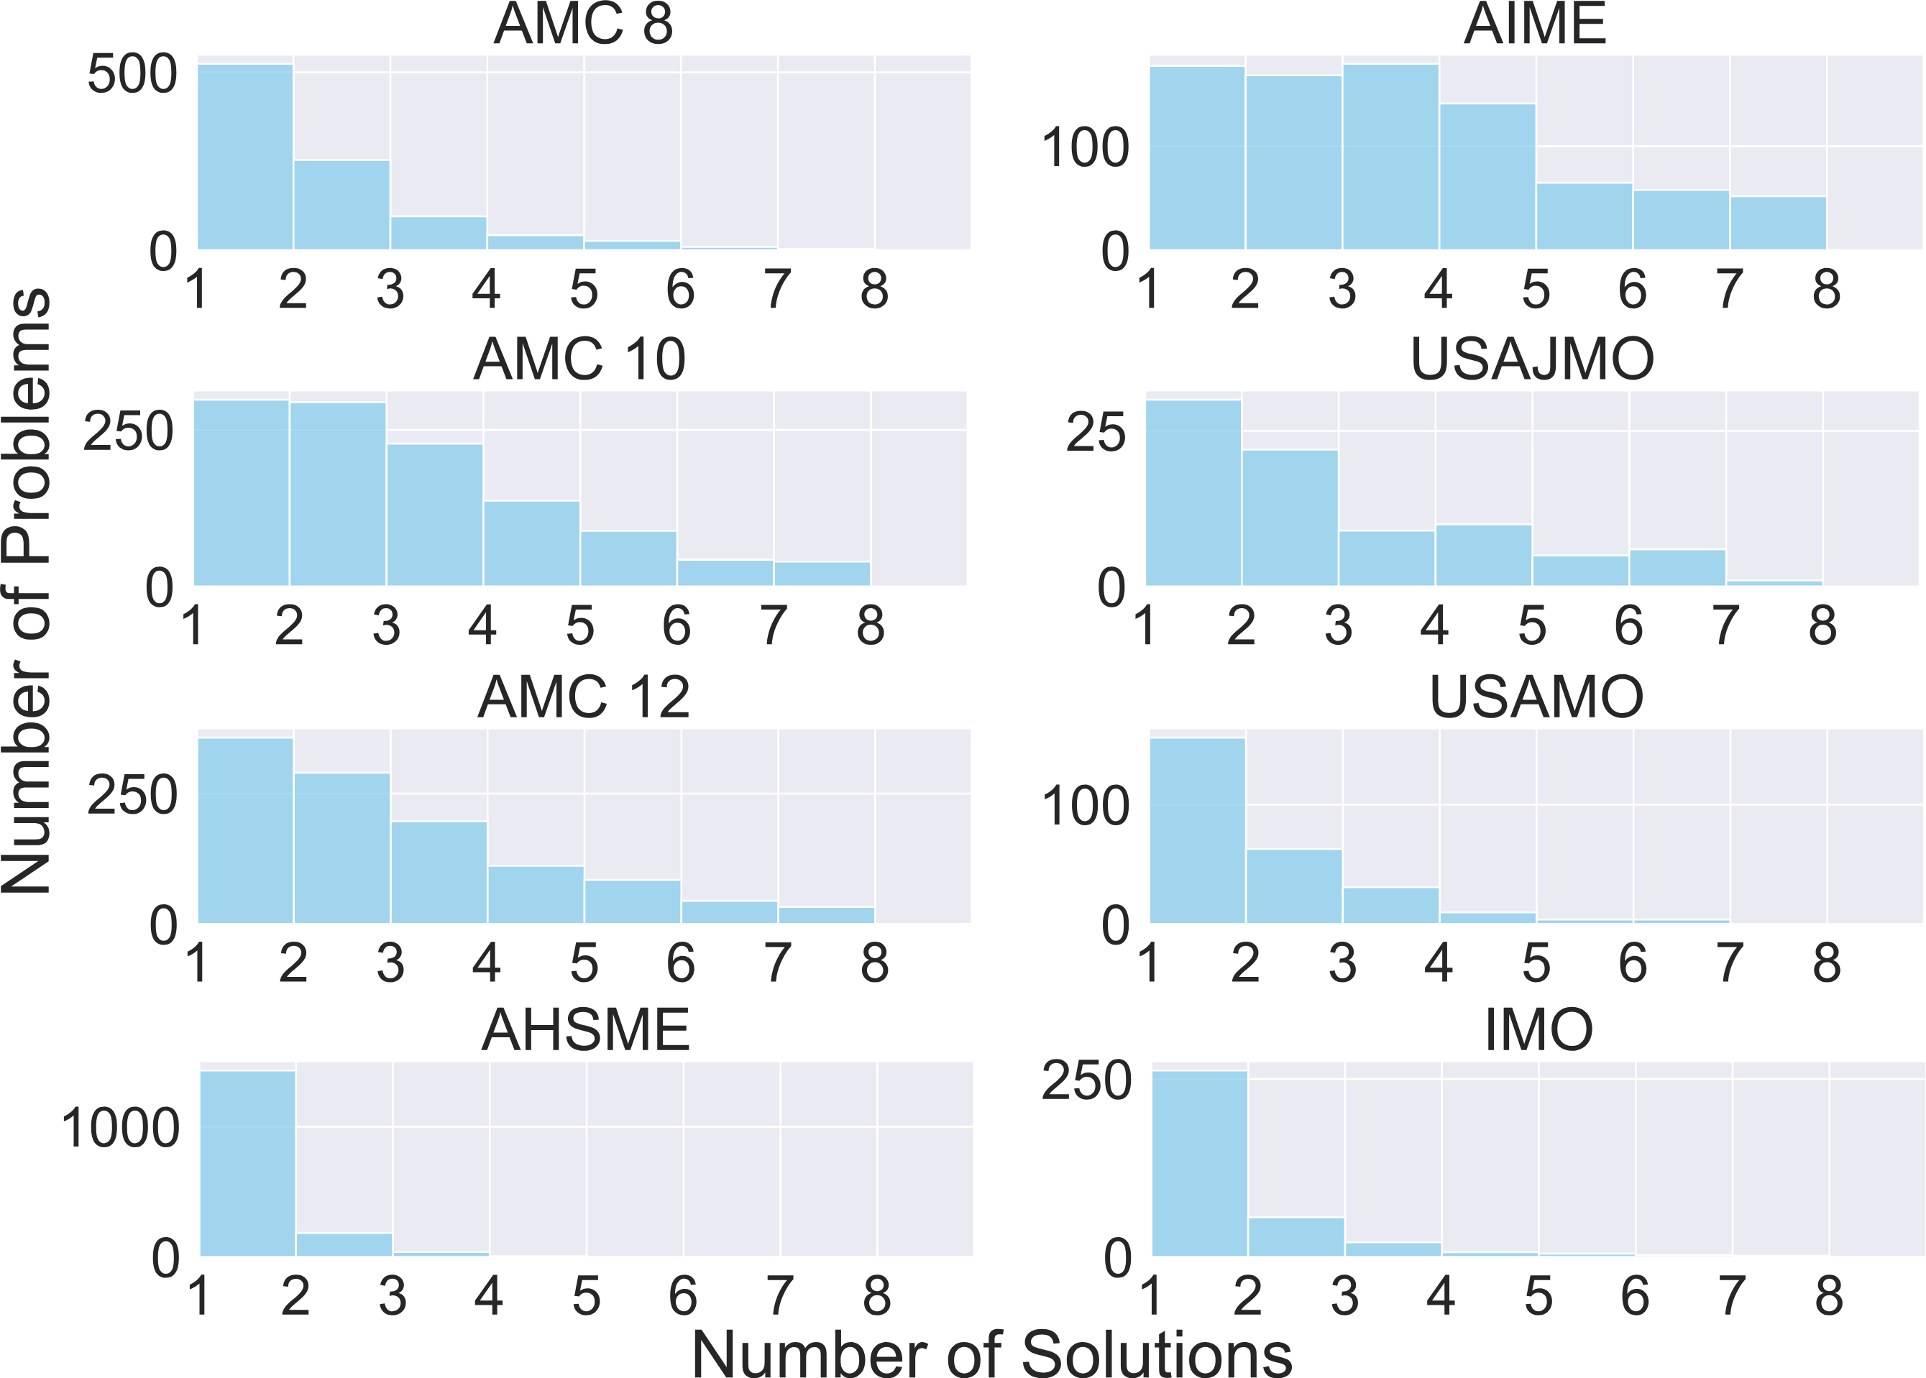
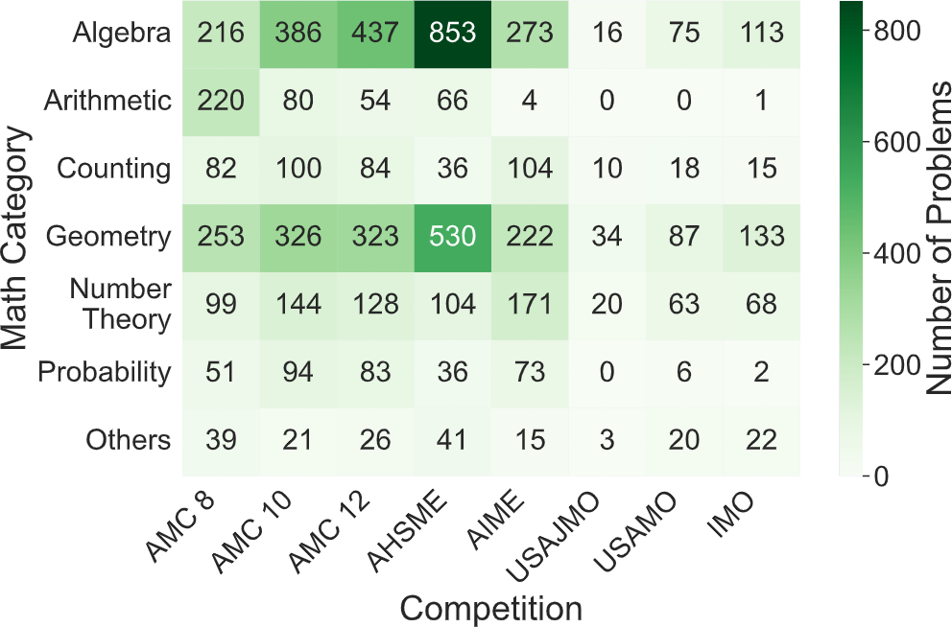
CreativeMath: A Benchmark Dataset
A broad range of mathematical topics, problem types, and covers different difficulty levels.
8 major US competitions: AMC 8, AMC 10, AMC 12, AHSME, AIME, USAJMO, USAMO, and IMO.
CreativeMath comprises high-quality mathematical problems from various competitions and their numerous solutions.
6,469 problems with 14,223 solutions

Slide 7
Dataset Creation
Data Collection
Source: Art of Problem Solving(AoPS).
Solutions submitted by competition participants.
Approximate the complete set of viable human solutions for each problem.
Earlier solutions are often the most common and intuitive, while later ones may build on previous methods, offer improvements, or introduce entirely novel algorithms.
Data Cleaning
HTML to latex
Remove incomplete problem and solutions
Remove problems with images
Notes:
The dataset was sourced from the Art of Problem Solving, a platform offering the most comprehensive collection of problems from various math competitions, along with multiple solutions contributed by participants over the years.
As the most popular resource for math competitors, AoPS effectively functions as a natural crowdsourcing platform. It uniquely approximates the complete set of viable human solutions for each problem, with later contributors often building on earlier ones.

Slide 8
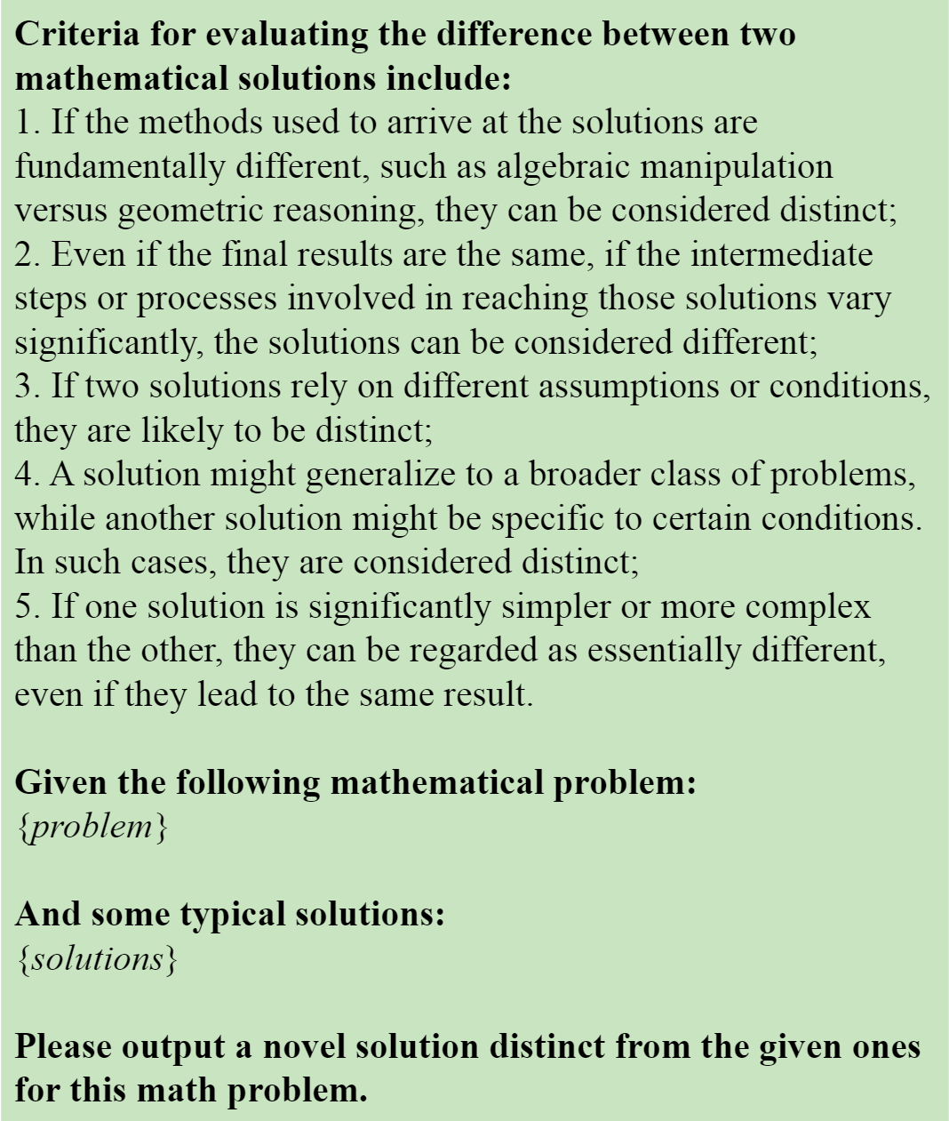
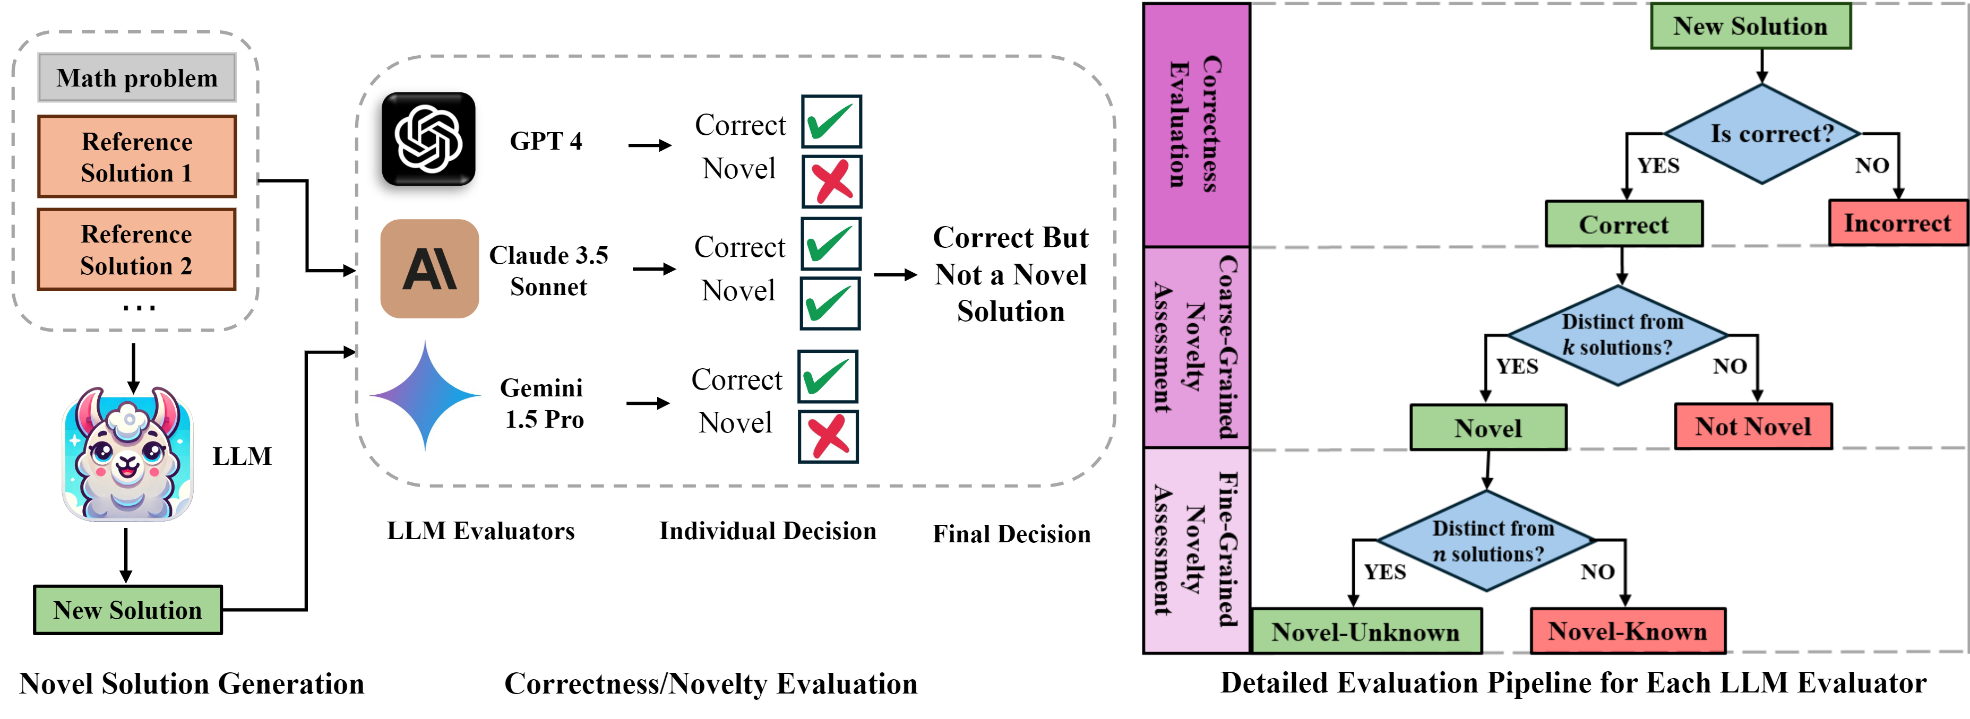
STAGE 1:
Novel Solution Generation
Generate a new solution that is distinct from k reference solutions.
k solutions are sequentially selected based on the order in which competitors uploaded their solutions on the website.
When k increases, the difficulty in generating novel solutions also increases.
k ranges from 1 to n.
n is the total number of available reference solutions.
Notes:
The first stage of the methodology aims to generate novel solutions for the given mathematical problem using LLM.
Earlier solutions are often the most common and intuitive, while later ones may build on previous methods, offer improvements, or introduce entirely novel algorithms.
Consequently, as k increases, the difficulty in generating new and innovative solutions also increases.

Slide 9
STAGE 2:
Correctness and Novelty Evaluation
2.1 Correctness Evaluation
2.2 Coarse-Grained Novelty Assessment
2.3 Fine-Grained Novelty Assessment

Slide 10
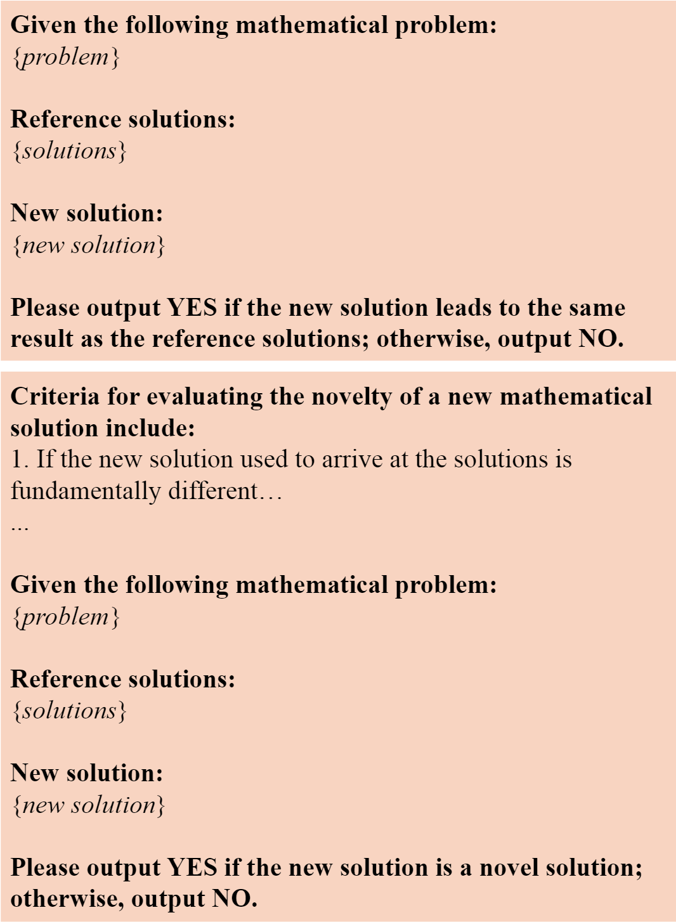
STAGE 2:
Correctness and Novelty Evaluation
STAGE 2:
Correctness and Novelty Evaluation

Slide 11
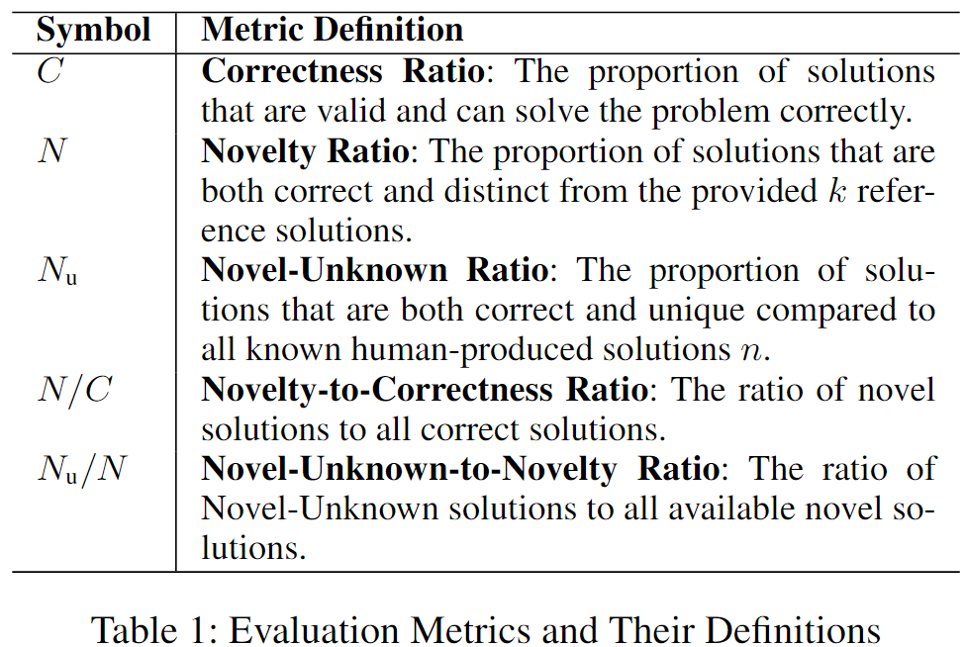
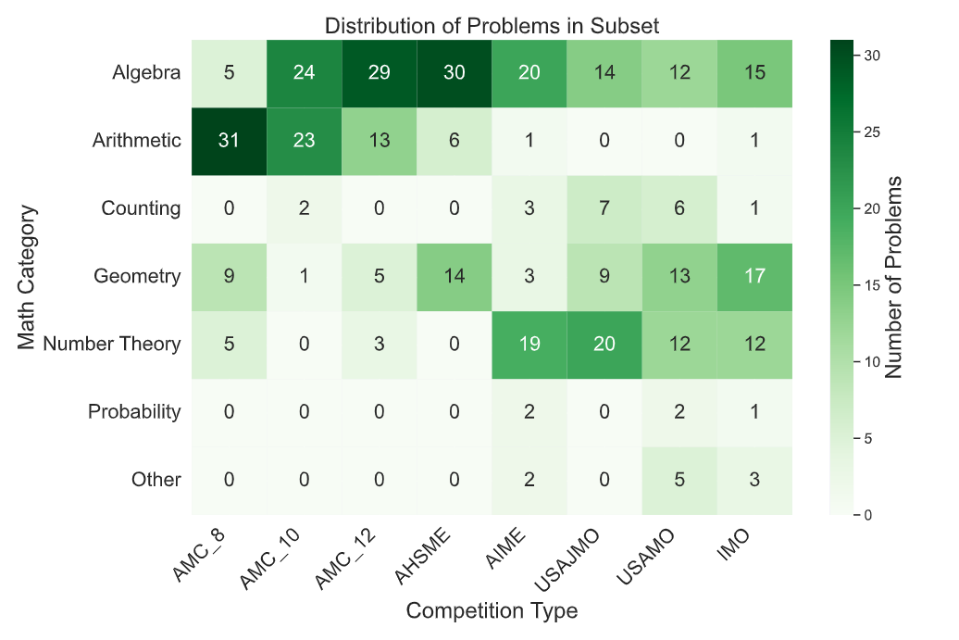
Experiment Setting
Dataset: CreativeMath Subset
Randomly selected 50 problems/competition (400 math problems and 605 solutions with k varying from 1 to at most 5)
Limit prompt length to 3K tokens
1K tokens are reserved for new solution generation.
Evaluation Metrics
Evaluation Metrics

Slide 12
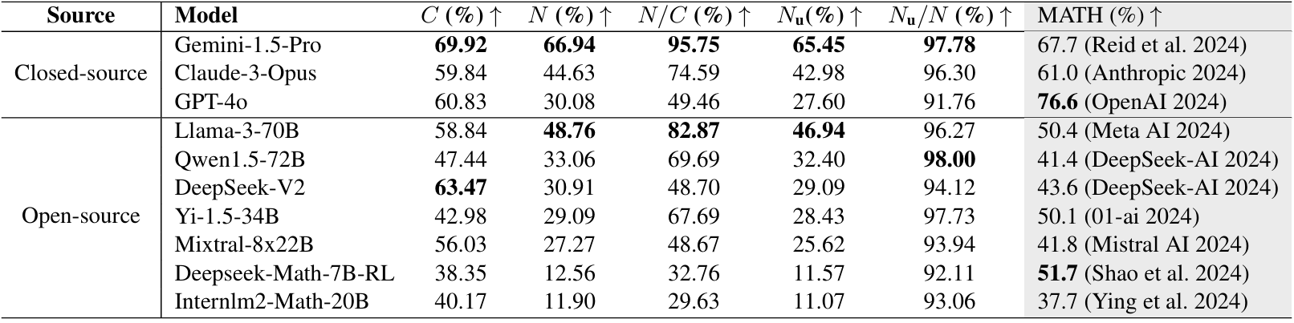
How Effectively Can LLM Generate A Novel Solution?
Key Findings:
🔹 Gemini-1.5-Pro excels in generating novel solutions.
🔹 Smaller and math-specialized models show lower performance in novelty generation.
🔹 A clear distinction between traditional math problem-solving and novel solution generation.
Notes:
Gemini-1.5-Pro demonstrates superior creativity in math problem-solving compared to other models with a high Novelty Ratio and a Correctness Ratio.
Llama-3-70B stands out among open-source models with a strong Novelty-to-Correctness Ratio (82.87%), outperforming closed-source models Claude-3-Opus and GPT-4o in novelty generation despite comparable correctness levels.
Smaller and math-specialized models like Yi-1.5-34B, Deepseek-Math-7B-RL, and Internlm2-Math-20B show lower performance in novelty generation, aligning with scaling laws that suggest larger models generally perform better.
Models like GPT-4o, despite high problem-solving accuracy, struggle with novelty generation, illustrating the more demanding nature of generating innovative solutions.

Slide 13
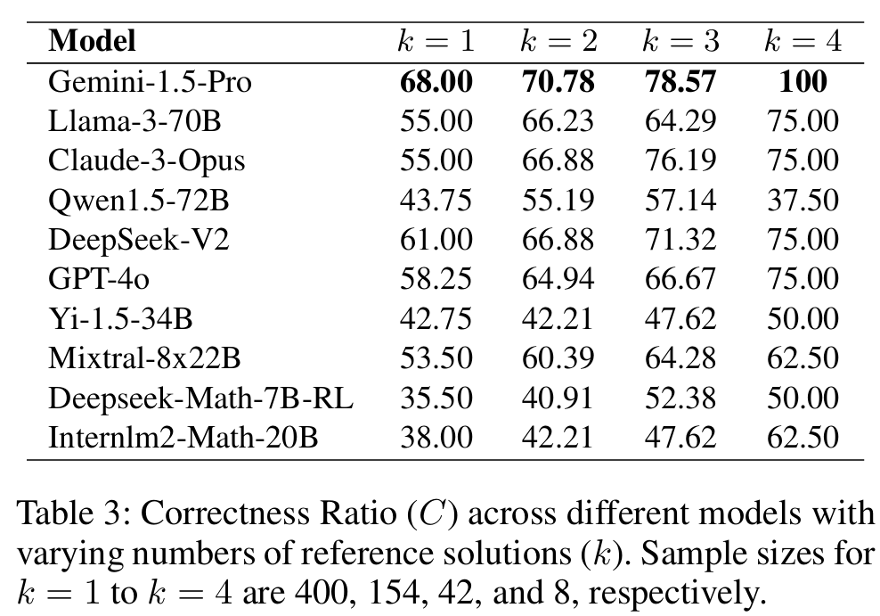
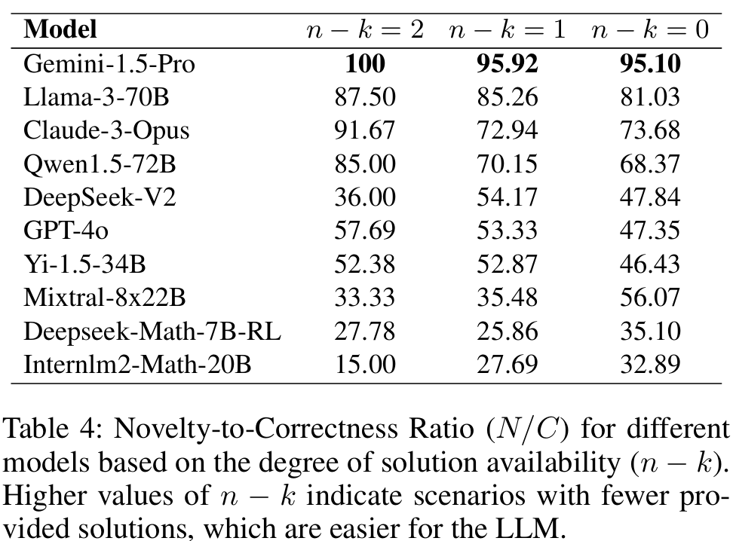
How Does k Affect LLM’s Performance?
Impact of the Degree of Solution Availability (n − k) on Novelty
Impact of k on Correctness
Correctness increases
Novelty decreases
🔹 When k increases, the correctness ratio increases. (Align with few-shot learning).
🔹 When n-k decreases, novelty-to-correctness ratio drops.
Notes:
A higher n−k means fewer distinct solutions are given, leaving more room for the model to explore and innovate.
This typically results in fewer constraints, facilitating the generation of novel outputs. As k increases and n − k decreases, the model is exposed to more reference solutions, tightening the constraints and making it harder to generate novel solutions.

Slide 14
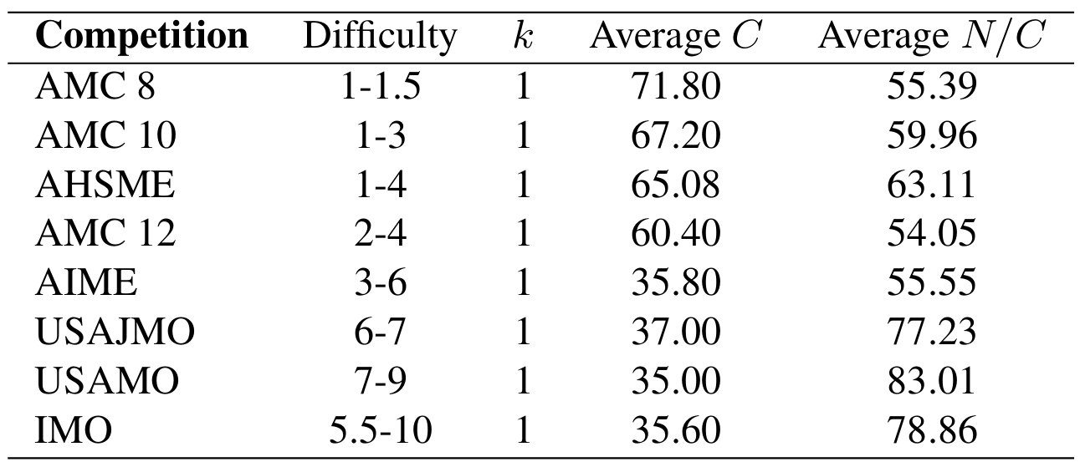
How Does Difficulty Level Affect LLM’s Performance?
Findings:
🔹 LLMs struggle with accuracy on harder problems, they are more likely to generate novel solutions when they do succeed.
🔹 A shift in the balance between familiarity and innovation
Difficulty
decreases
Correctness
decreases
Novelty
increases
Notes:
Table 5: Average Correctness (C) and Novelty-to Correctness Ratio (N/C) for all LLMs when solving math problems of varying difficulty levels, with k = 1 across all competitions.
When difficulty level increases,
correctness ratio decreases.
novelty-to-correctness ratio increases.
A shift in the balance between familiarity and innovation: as problem difficulty rises, LLMs are pushed to rely less on familiar strategies and more on creative problem-solving.

Slide 15
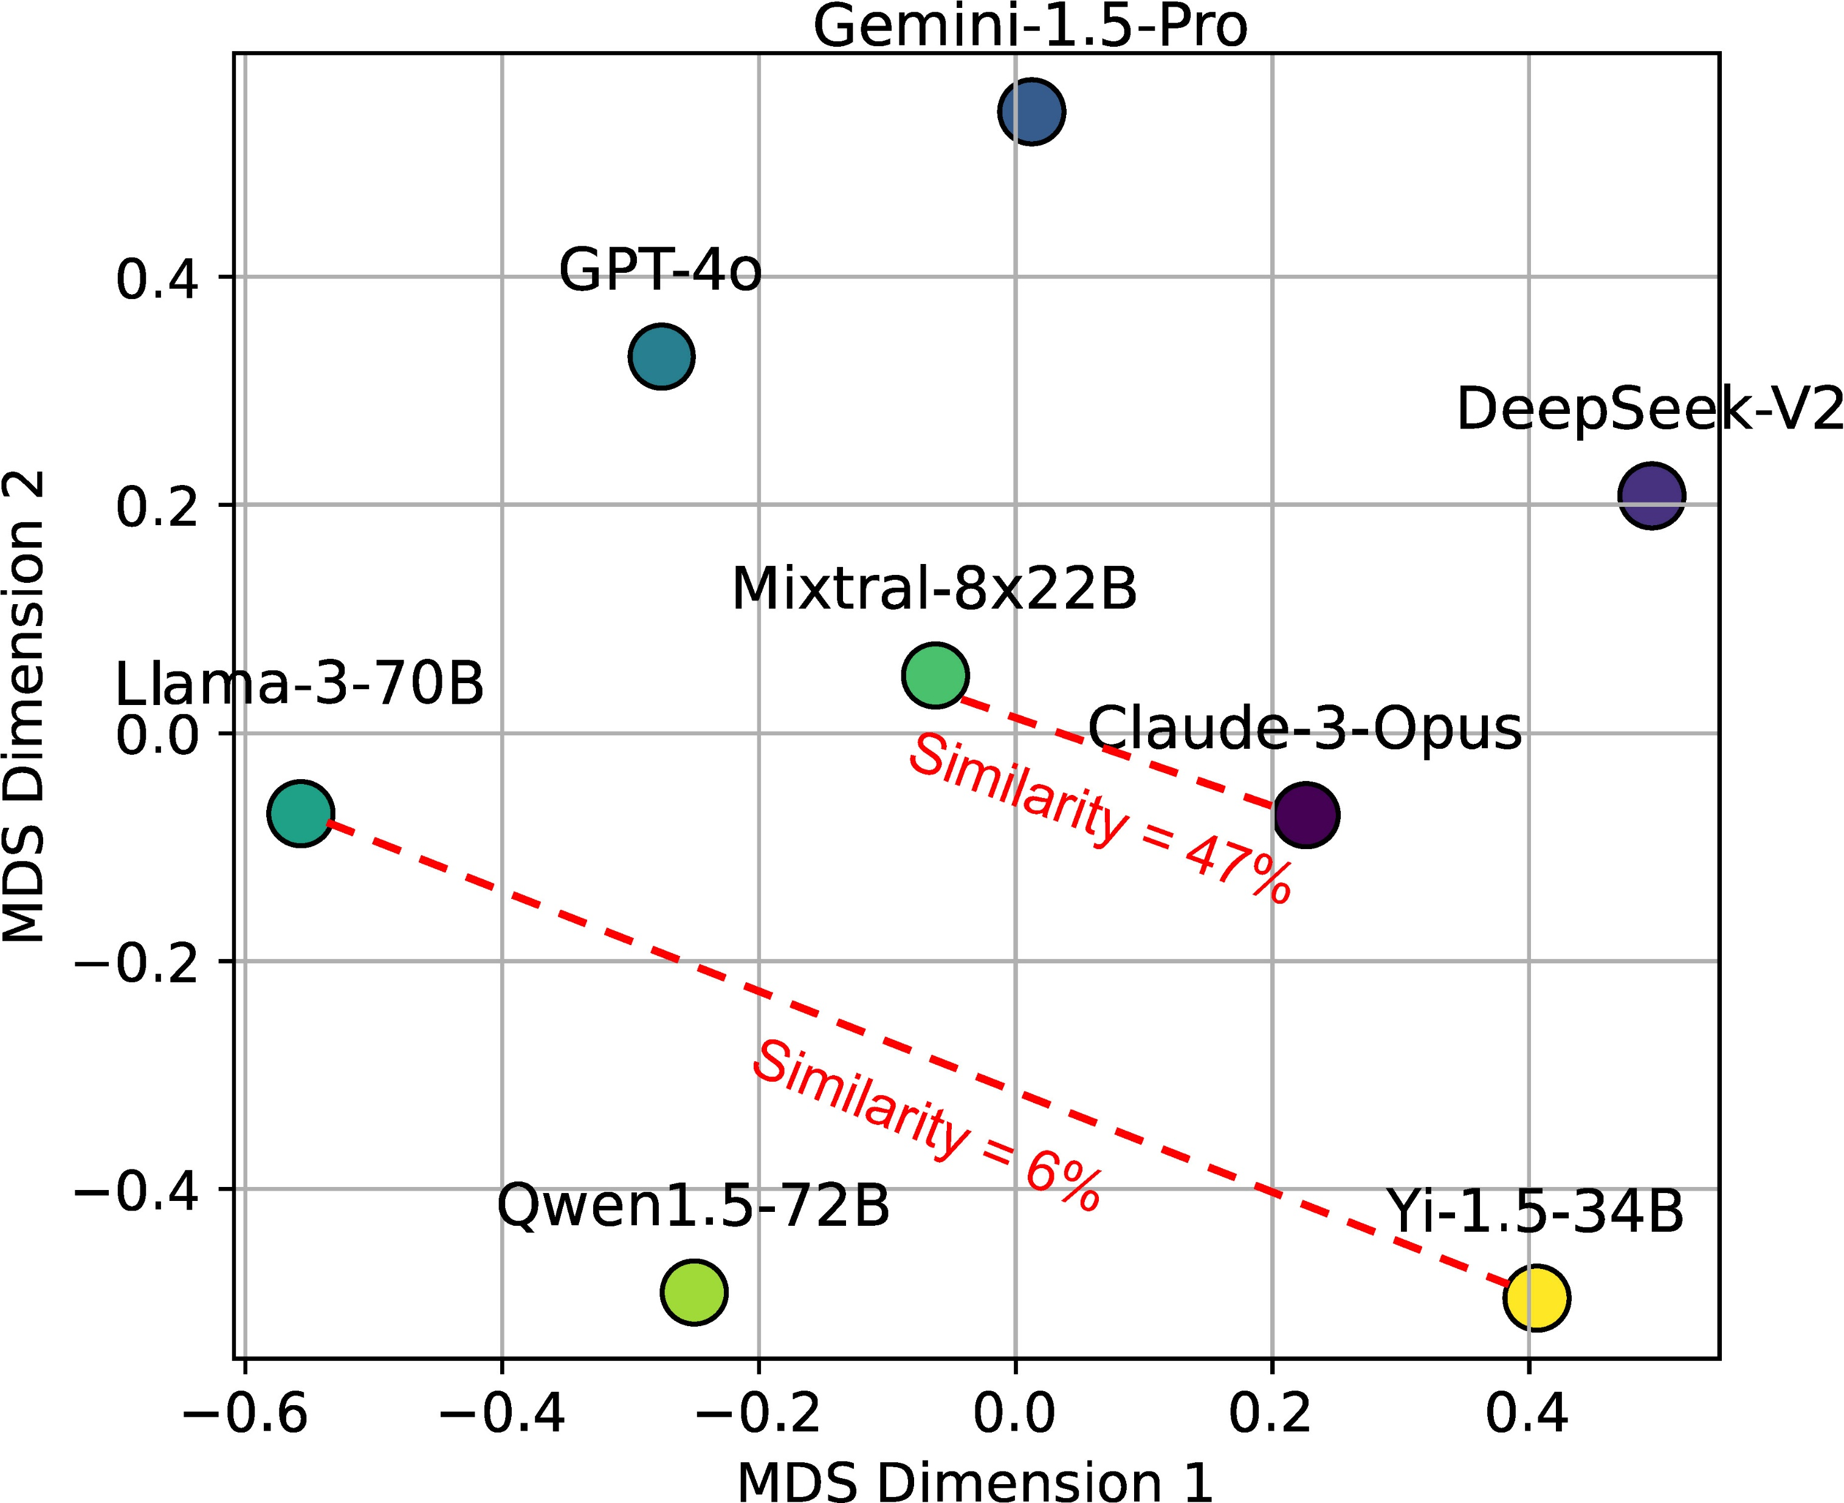
Similarity Map Between Novel Solutions Generated By Different LLMs
Step 1: Measure pairwise similarity between the outputs of various LLMs.
Step 2: Map similarity matrix into 2D plane with Multidimensional Scaling (MDS).
Findings:
🔹 Low similarity between the novel solutions generated by different LLMs.
🔹 Leverage LLMs on the periphery to generate diverse solutions.
Notes:
We select samples where all LLMs were capable of generating novel solutions.
Use the same prompt as in the novelty assessment to identify whether two solutions are distinct. (replaced the reference solution with the solution generated by one LLM and the new solution with that generated by another LLM.)
A general trend of low similarity between the novel solutions generated by different LLMs.
The most similar pair, Mixtral-8x22B and Claude-3, shows a 47% similarity
The most distinct pair, Llama-3-70B and Yi-1.5-34B, shows only a 6% similarity
This analysis suggests that leveraging multiple LLMs positioned on the periphery of the similarity map could be a promising approach to generate diverse novel solutions.

Slide 16
Conclusion
🔹 CreativeMath Dataset: Introduced a dataset to assess LLMs' creative problem-solving.
🔹 Framework: Developed a system to generate novel solutions and measure both accuracy and innovation.
🔹 Key Findings: Found significant variability in LLMs' creative abilities.
🔹 AI Advancement: Stressed the need for AI to offer original insights, not just correct answers.
🔹 Future Research: Encouraged deeper exploration of LLM creativity in complex domains like math.
Notes:
In this study, we introduced the CreativeMath dataset and developed a comprehensive framework that includes both the generation of novel solutions by LLMs and their evaluation.
This framework is designed to assess the creative potential of LLMs in mathematical problem solving, systematically distinguishing between solutions that are merely correct and those that offer innovative approaches.
Our findings reveal significant variability in the creative abilities of state-of-the-art LLMs, emphasizing the importance of advancing AI systems that not only solve problems accurately but also contribute original insights.
We also encourage future research to delve deeper into methodologies for uncovering and assessing the creative capabilities of LLMs, particularly in complex and abstract domains like mathematics.

Slide 17









Thank You
Guiling Wang
Wenpeng Yin
Junyi Ye
Jingyi Gu
Xinyun Zhao
Suraj Patel
Venkata Sai
Lakshman Palli
Aadish Jain
Paper & Code

Slide 18
Reference
Runco, M. A.; and Jaeger, G. J. 2012. The standard definition of creativity. Creativity research journal, 24(1): 92–96.
Art of Problem Solving. “AoPS Wiki”, https://artofproblemsolving.com/wiki/.

